Slide 1
MARKETING AND RETAIL ANALYTICS
Created by Shubhasree Sarkar

Slide 2
Agenda
This project aims to find the underlying buying patterns of the customers of an automobile part manufacturer based on the past 3 years of the Company's transaction data and hence recommend customized marketing strategies for different segments of customers.

Slide 3
Contents
Problem statement
Data Dictionary
About Data
Data Info
Shape,
Summary Stats
Assumptions about data
Exploratory Data Analysis
Univariate Analysis
Bivariate Analysis
Multivariate Analysis
Weekly, Monthly, Quarterly, Yearly Trends in Sales
Sales Across different Categories of different features in the given data
Summarization from the above analysis

Slide 4
Contents
Customer Segmentation using RFM analysis (make 4 segments)
What is RFM?
What all parameters used and assumptions made
Output table head
Inferences from RFM Analysis and identified segments
Best customers?
Customers on the verge of churning?
Lost customers?
Loyal customers?

Slide 5
Problem Statement
An automobile parts manufacturing company has collected data of transactions for 3 years. They do not have any in-house data science team, thus they have hired you as their consultant. Your job is to use your magical data science skills to provide them with suitable insights about their data and their customers.
Dataset provided –
Tools used –
Tableau
https://public.tableau.com/app/profile/shubhasree.sarkar/viz/MRA_Project_16532392587020/QuantityOrdered-Sales?publish=yes
Python
KNIME

Slide 6
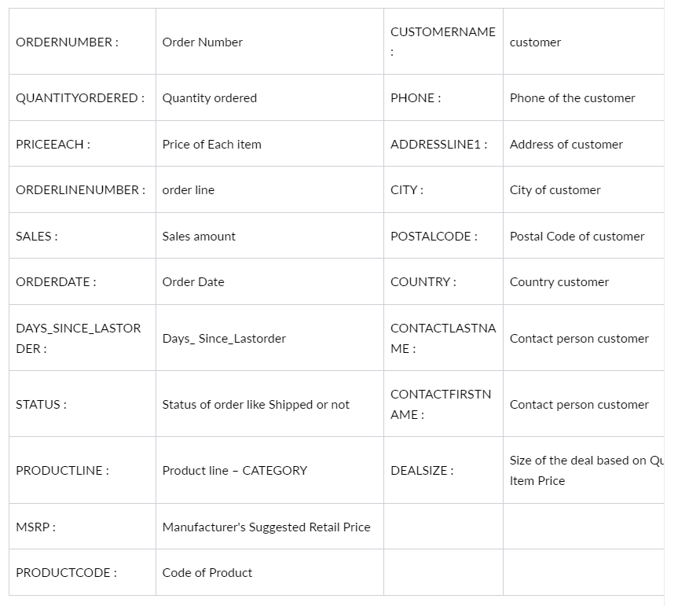
Data dictionary

Slide 7
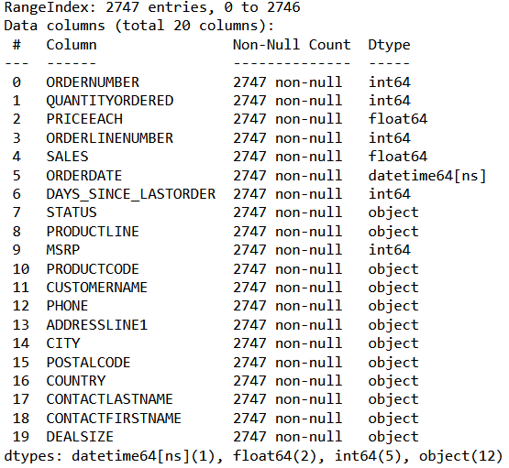
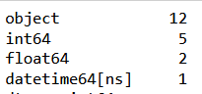
About data
Interpretation
The dataset contains 20 variables and 2747 records-
Categorical type – 12
Integer type – 5
Float type – 2
Date-time type – 1
There are no missing values and duplicate values

Slide 8
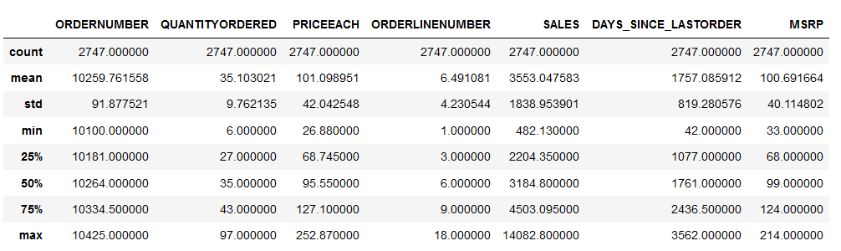
About data
DATA SUMMARY- CONTINUOUS VARIABLES

Slide 9
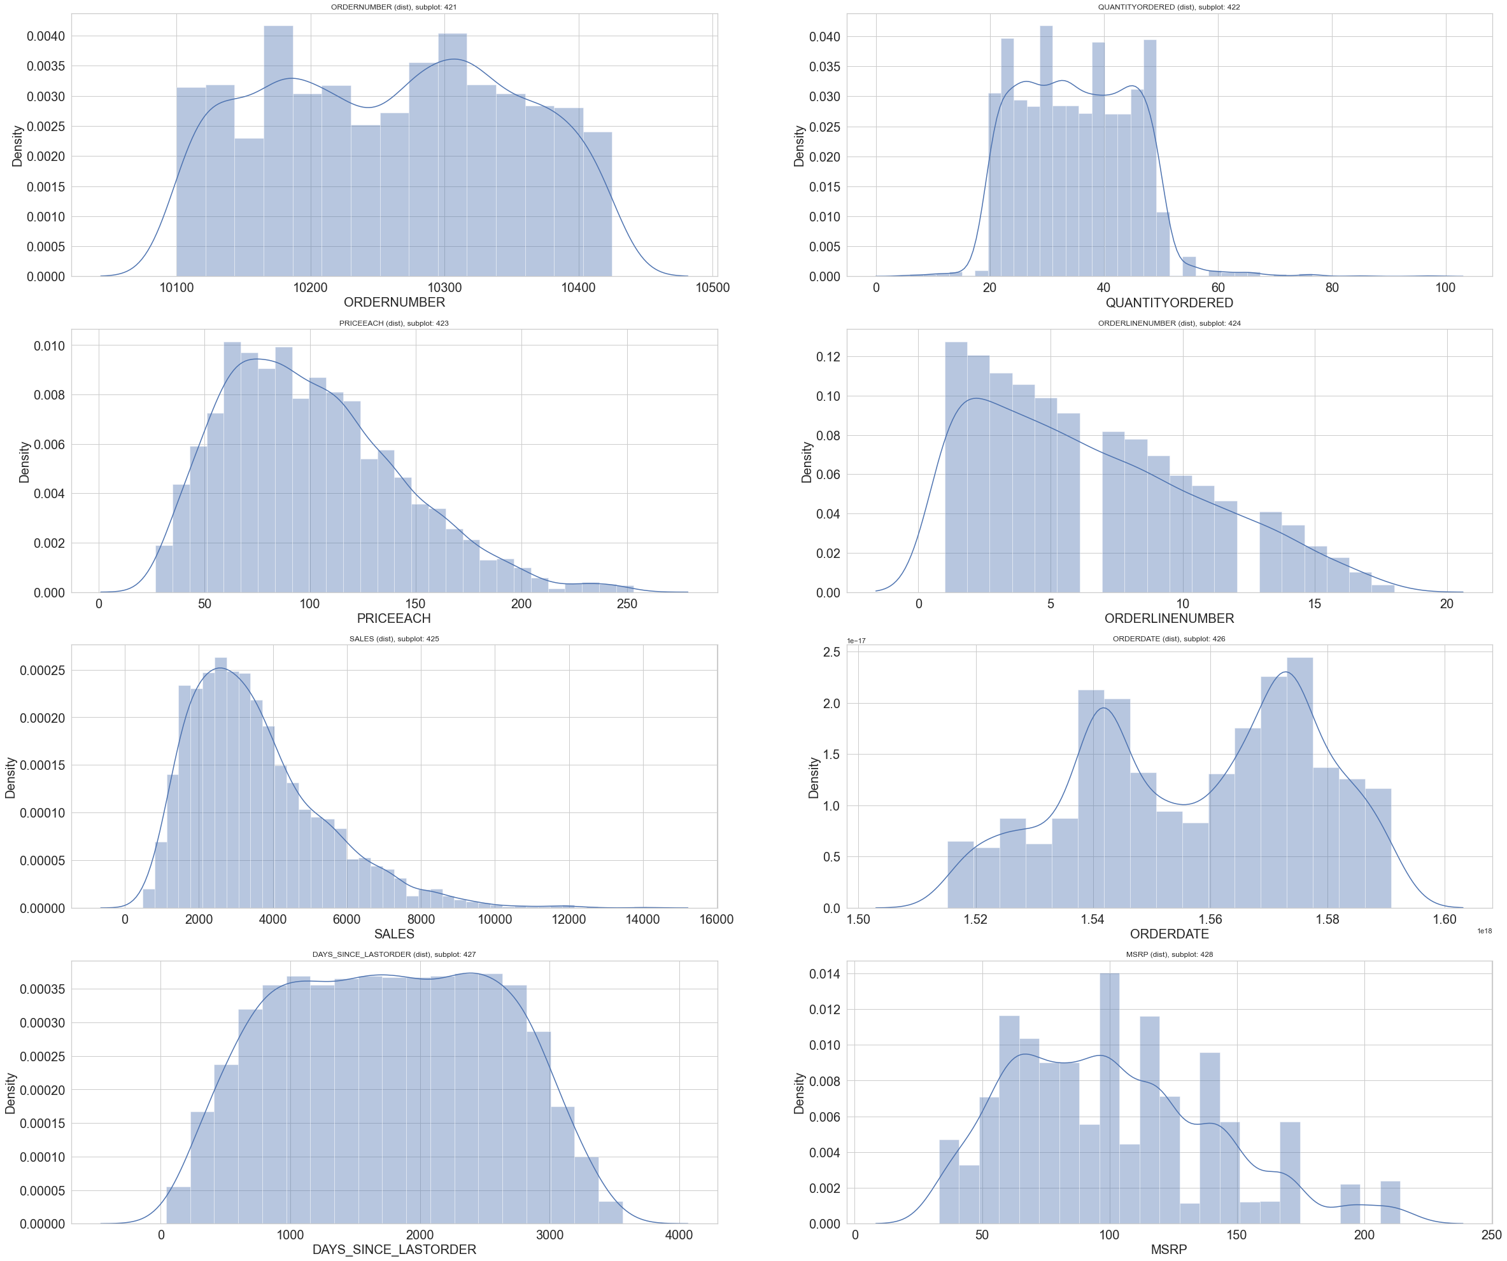
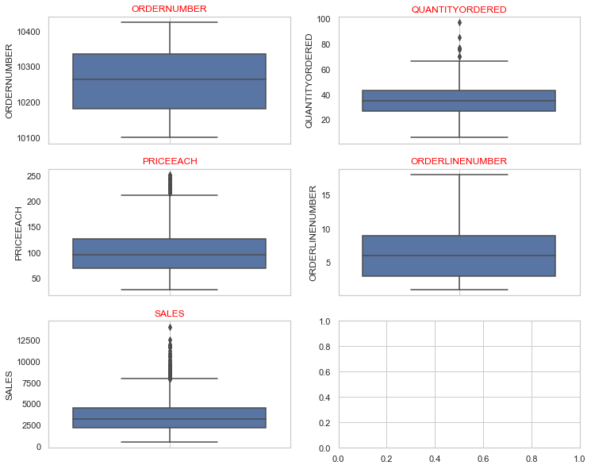
Exploratory data analysis - Univariate
QUANTITY ORDERED
From the above two diagrams we can confirm that the quantities ordered have presence of outliers, with majority of the quantity volumes between 20-50 units. Hence, the data is not normally distributed.
PRICE EACH
From the above two diagrams we can confirm that the price of each quantity has presence of outliers, with majority of the price range between 50-150 units. Hence, the data shows skewness(slight rightly skewed)

Slide 10
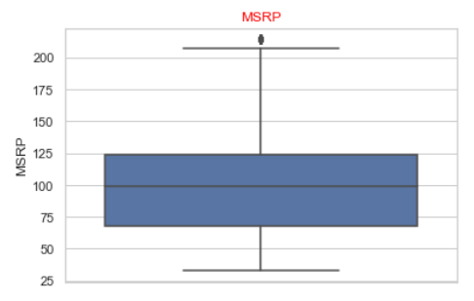
Exploratory data analysis - Univariate
SALES
From the above two diagrams we can confirm that the Sales data has presence of outliers, with majority of the Sales value between 1800-5000 units. Hence, the data shows skewness (right skewed)
MSRP
From the above two diagrams we can confirm that the MSRP data has little outliers, with majority of the values between 50-150 units. Hence, the data shows more or less normal distribution

Slide 11
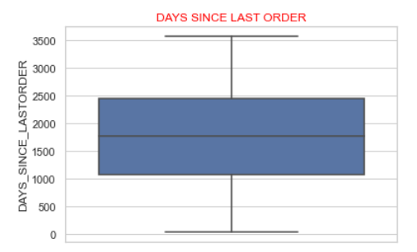
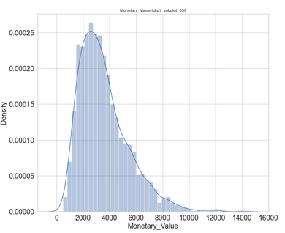
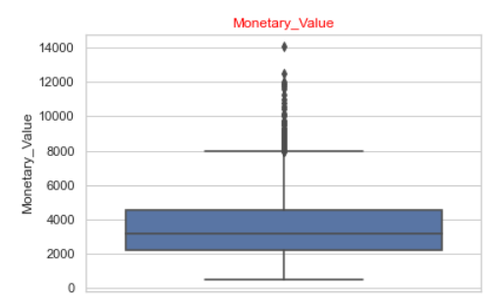
Exploratory data analysis - Univariate
DAYS SINCE LAST ORDER
From the above two diagrams we can confirm that the Days since last Order/ Frequency has no presence of outliers, with the data showing Normal Distribution
MONETARY VALUE
From the above two diagrams we can confirm that the Monetary data has huge no. of outliers, with majority of the values between 1000-5500 units. Hence, the data shows skewness (right skewed)

Slide 12
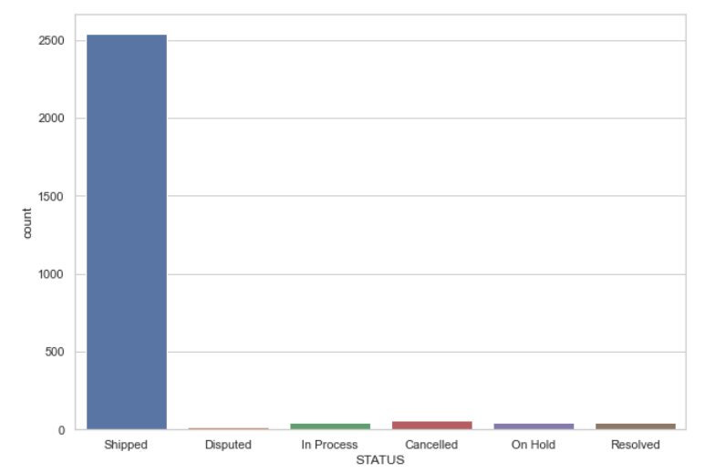
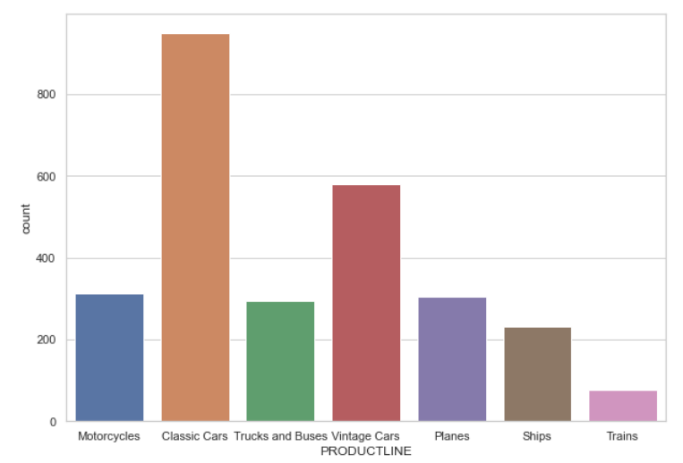
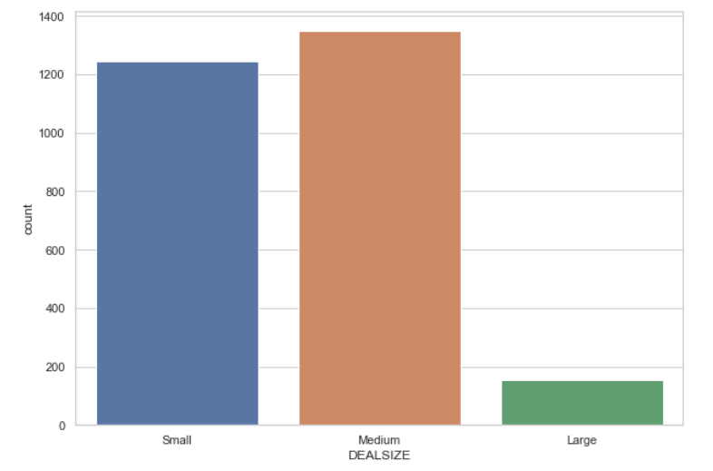
Exploratory data analysis - Univariate
STATUS
PRODUCT LINE
DEAL SIZE
From the above Bar plot, regarding Status we can conclude that the Shipping Status has the major status for most items, with Disputed status being the minority
From the above Bar plot, regarding Product Line we can conclude that the Classic Cars are in majority, with no. of Trains being the minority.
From the above Bar plot, regarding Deal Size we can conclude that the Medium size deals are in majority, with Large deals being the minority.

Slide 13
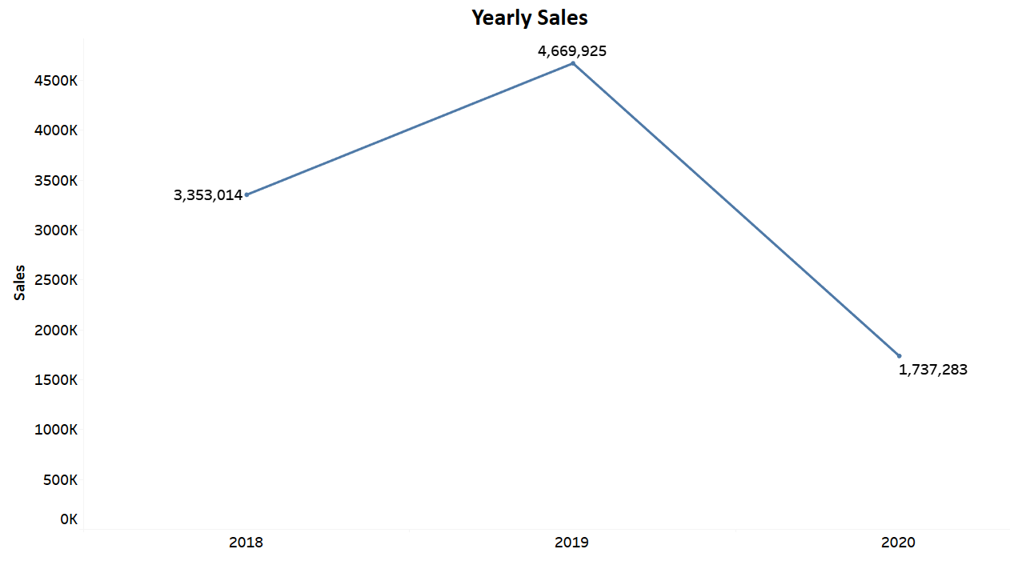
Exploratory data analysis – Bivariate Analysis
Yearly Sales
From the above graph we can confirm that from year 2018 onwards the sales has increased , becoming highest in 2019, which eventually dropped afterwards in 2020

Slide 14
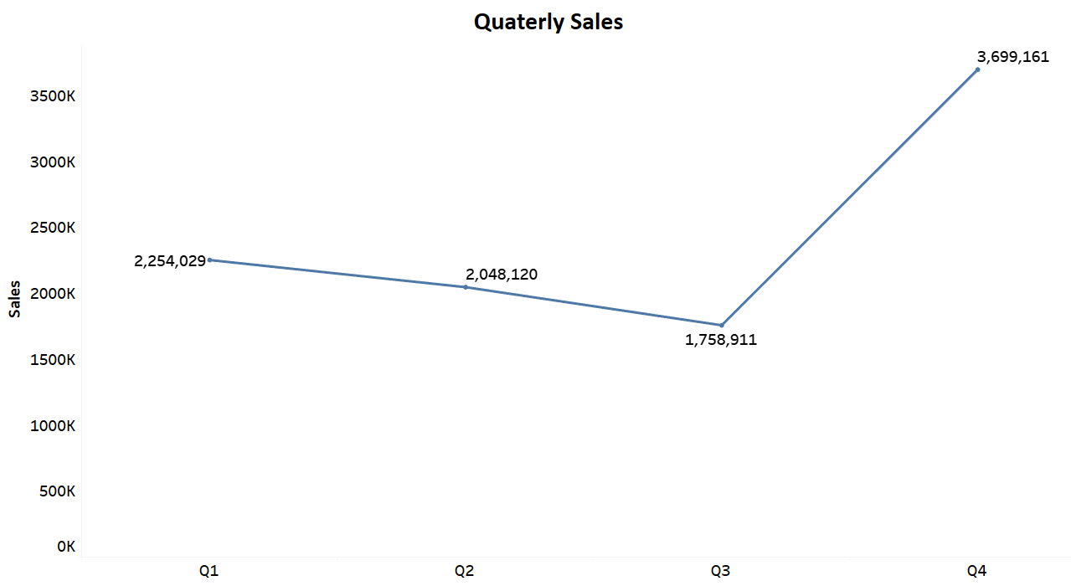
Exploratory data analysis – Bivariate Analysis
Quarterly Sales
From the above graph we can confirm that from Q1 till Q3 over years, the Sales have decreased, but reached its highest peak at Q4. Thus, it can be said that for the month of Oct, Nov and Dec, the Sales has been highest.

Slide 15
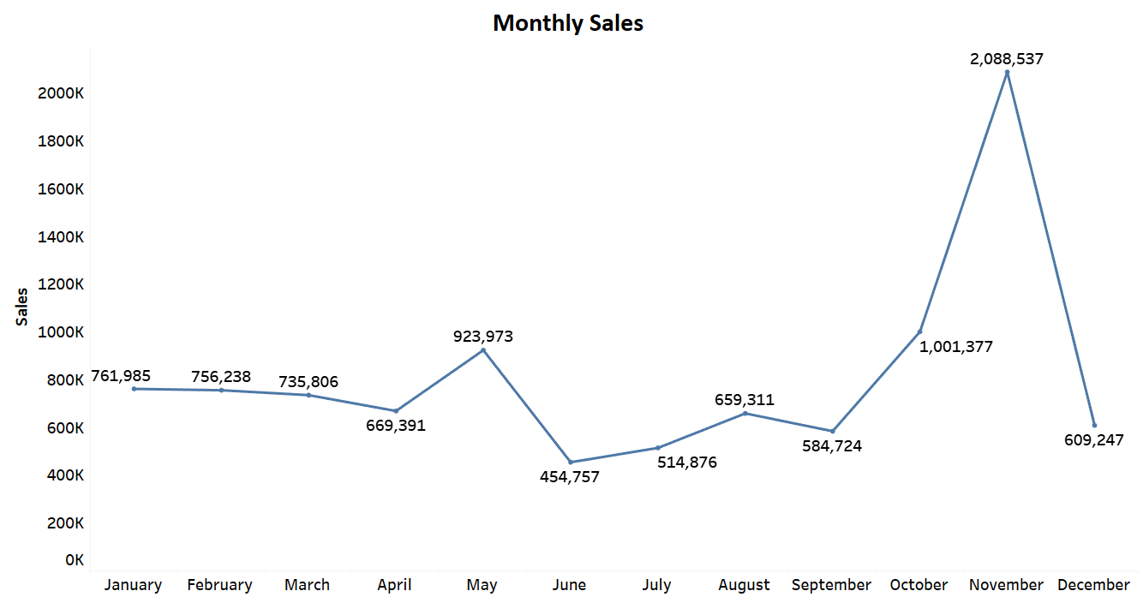
Exploratory data analysis – Bivariate Analysis
Monthly Sales
From the above graph we can confirm that from January to April, Sales slowed down, which increases on May, before falling on June. Eventually, it was more or less fluctuating till it reaches November, during which the Sales becomes Highest.

Slide 16
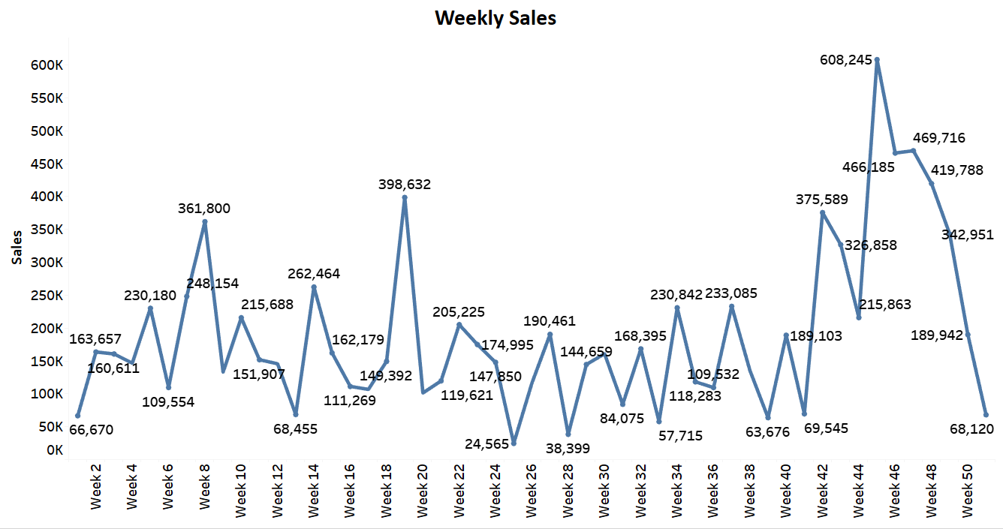
Exploratory data analysis – Bivariate Analysis
Weekly Sales
From the above graph we can confirm that over the weeks from week 0 to week 44, it has been fluctuating overall, until it reaches week 45, which has contributed to the highest sales before falling down steeply

Slide 17
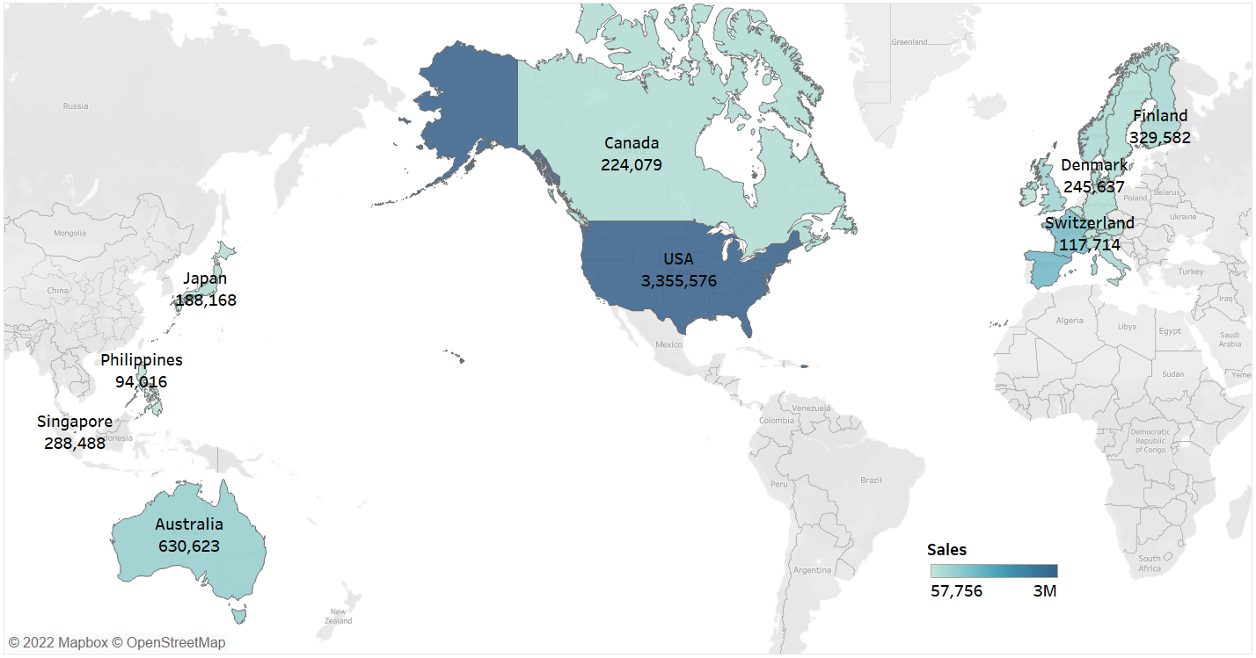
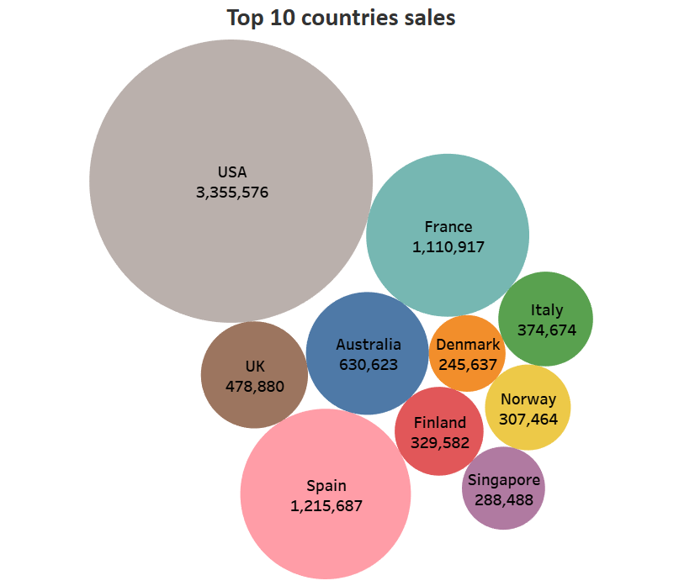
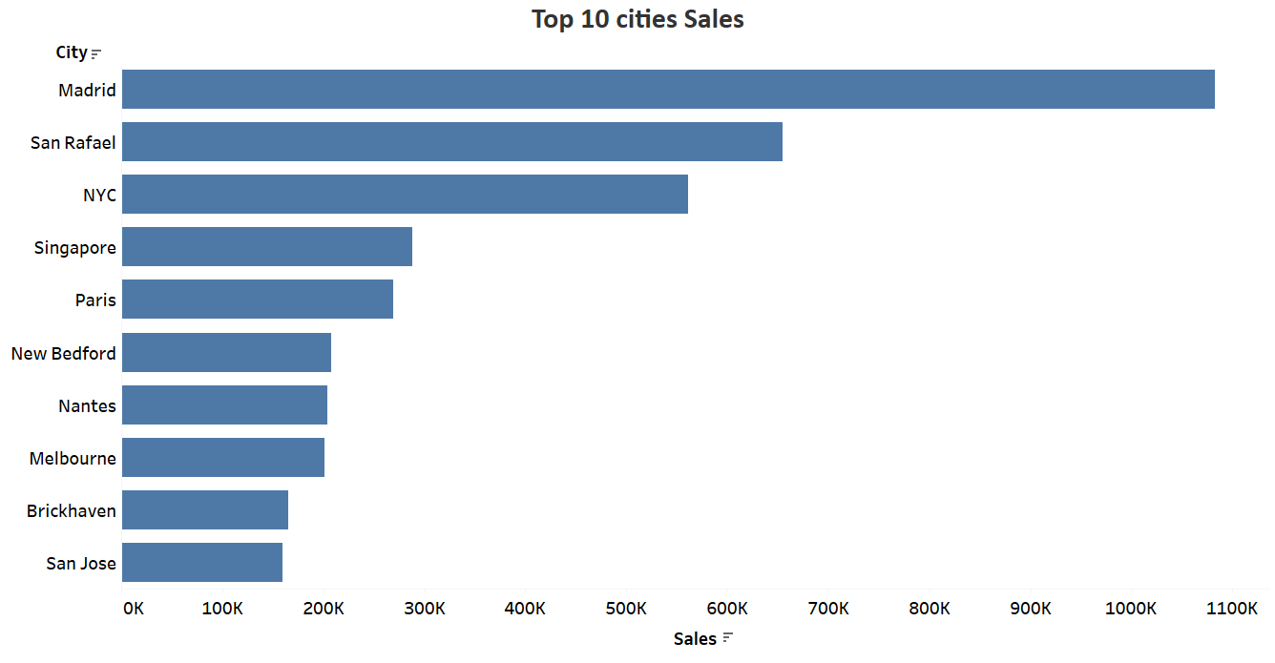
Exploratory data analysis - BIVARIATE
Country wise Sales
From the given graphs we can confirm that USA is the top country generating most sales, followed by Spain
City wise Sales
From the given graphs we can confirm that Madrid, Spain is the top city generating most sales, followed by San Rafael, USA

Slide 18
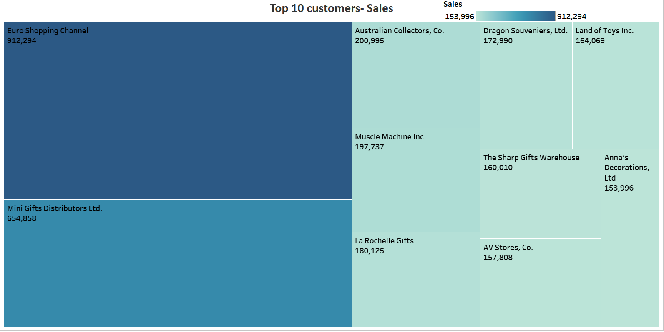
Exploratory data analysis - BIVARIATE
Customer wise Sales
From the above treemap diagram, we can conclude, that Euro shopping channel, contributes to the most amount of sales followed by Mini Gifts Distributors Ltd.

Slide 19
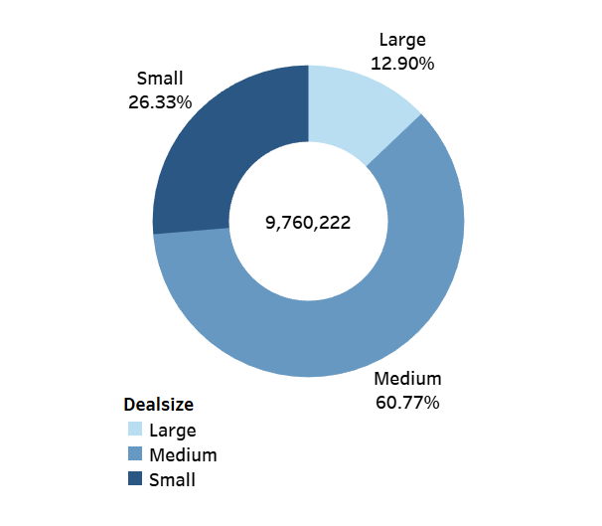
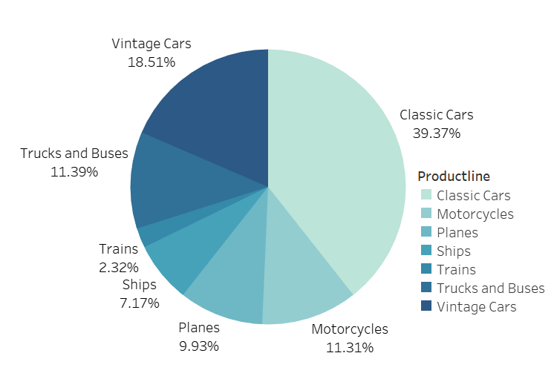
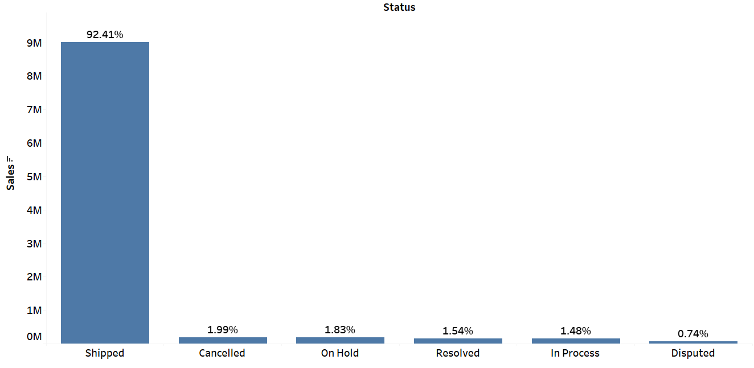
Exploratory data analysis - BIVARIATE
Deal-size wise Sales
Product-line wise Sales
Status wise Sales
From the above donut chart, we can conclude that Medium size deal has been the highest contributor (60.77%) in Sales, followed by Small size (26.33%), with large size deals being the lowest(12.90%)
From the above pie chart, we can conclude that Classic Cars has been the highest contributor (39.37%) in Sales, followed by Vintage cars (18.51%), with trains being the lowest contributor(2.32%)
From the above bar chart, we can conclude that Shipped items has been the highest contributor (92.41%) in Sales, followed by Cancelled ones (1.99%), with disputed ones being the lowest(0.74%)

Slide 20
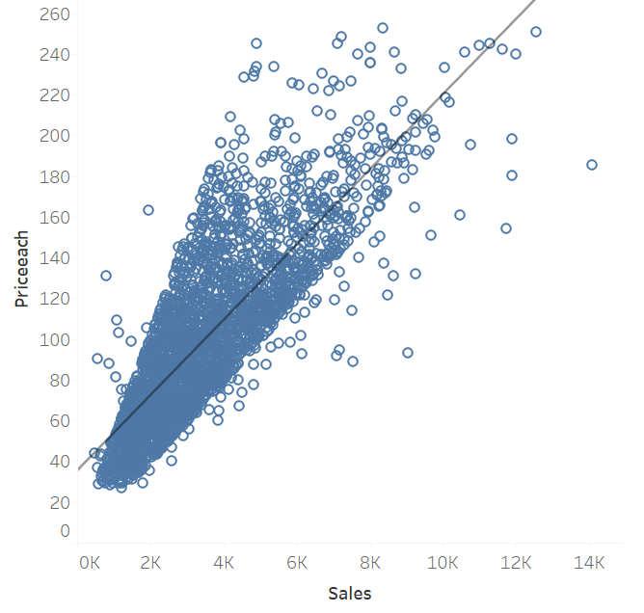
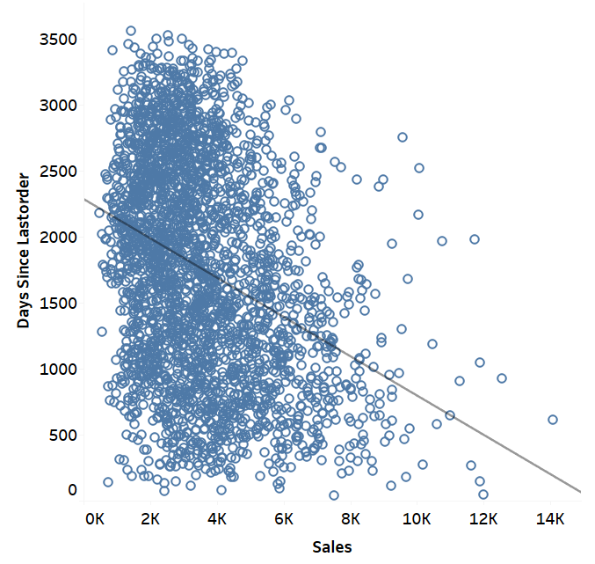
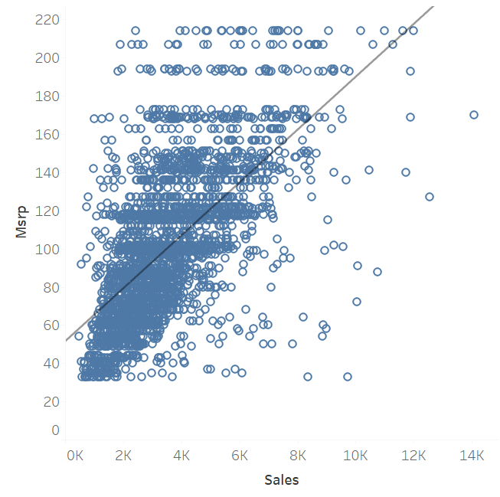
Exploratory data analysis - BIVARIATE
Price Each wise Sales
Product-line wise Sales
Status wise Sales
From the above Scatter plot, we can conclude that price per unit has a direct relationship with Sales, thus meaning that with increase in price of each item, Sales more or less increased following a straight line pattern.
From the above scatter plot, we can’t say much about the relationship between the Sales and the Days since last order as no pattern can be observed in general.
From the above scatter plot, we can’t say much about the relationship between the Sales and MSRP as no pattern can be observed in general, although in few cases, there has been an direct relationship between these two.

Slide 21
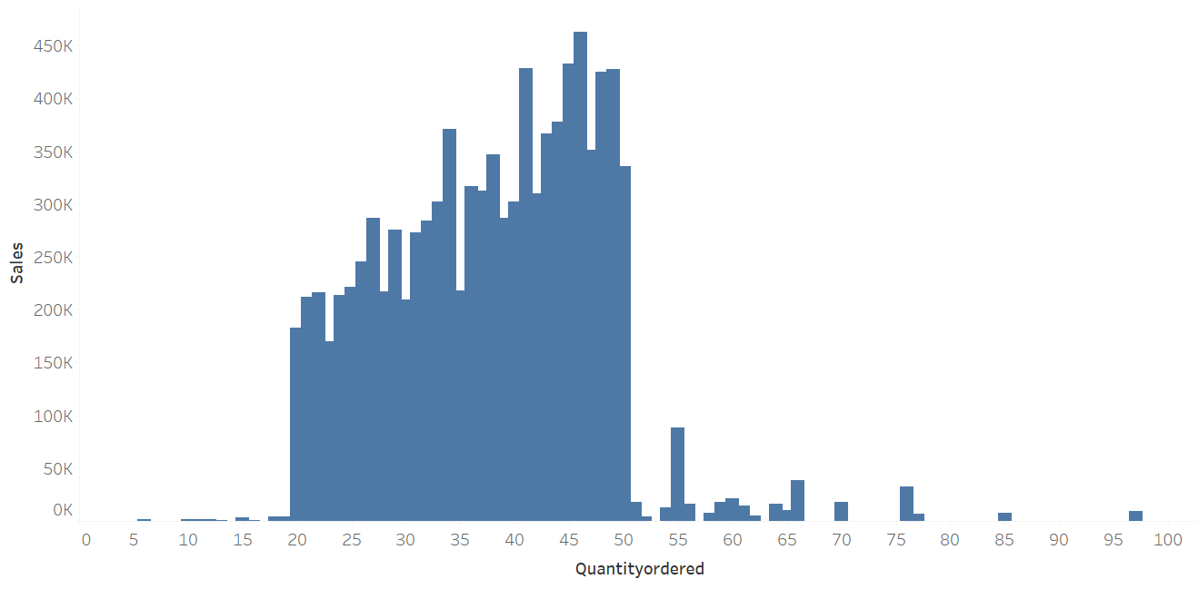
Exploratory data analysis - BIVARIATE
Quantities ordered vs Sales
From the above diagram, we can conclude that on an average, for Quantities ordered between 20-50 units, Sales range has been high and in majority.

Slide 22
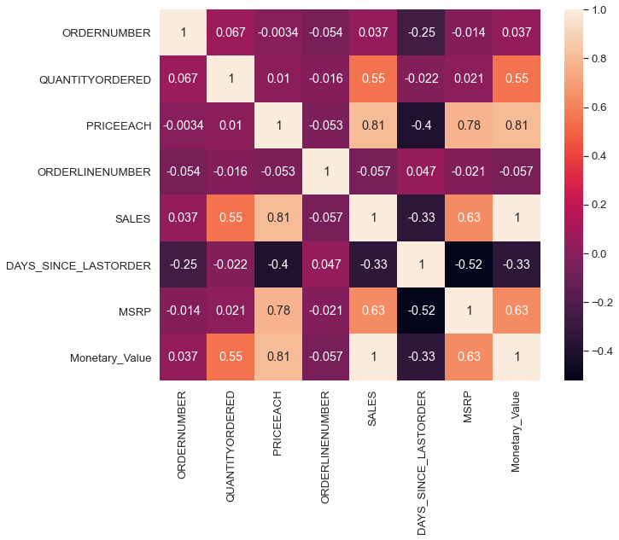
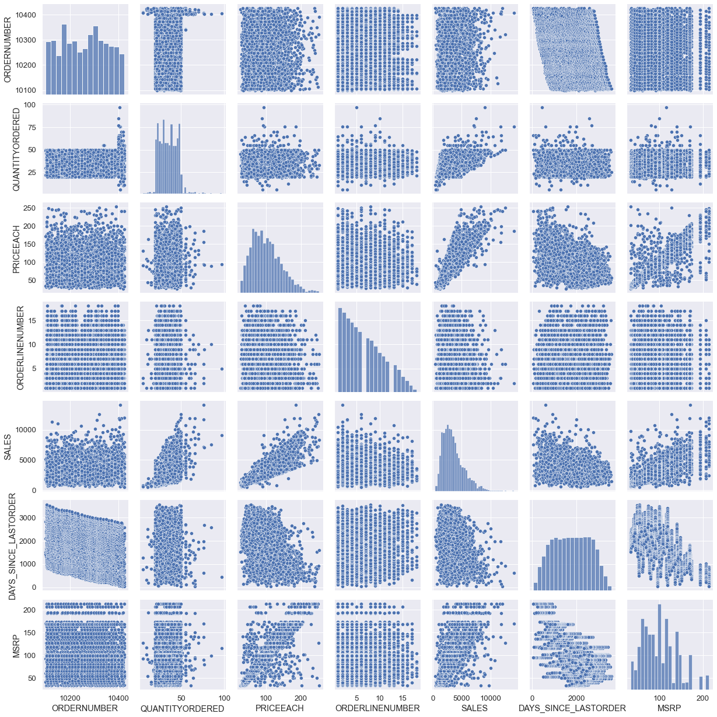
Exploratory data analysis - BIVARIATE
Quantities ordered vs Sales
From the above Correlation graph, we can conclude that –
Sales has highest correlation with Price Each, MSRP, Quantities ordered
Price Each has highest correlation with Sales, MSRP
Rest all the variables have negligible Correlation with each other

Slide 23
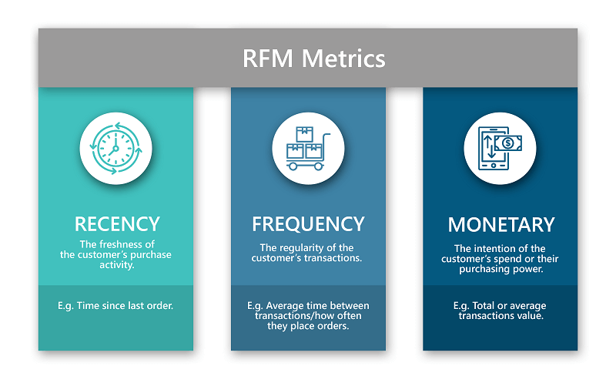
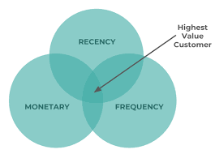
Customer Segmentation using RFM analysis
WHAT is R.f.m.?
RFM stands for recency, frequency, monetary value. In business analytics, we often use this concept to divide customers into different segments, like high-value customers, medium value customers or low-value customers, and similarly many others.

Slide 24
Customer Segmentation using RFM analysis
WHAT ALL PARAMETERS USED AND ASSUMPTIONS MADE
The parameters that are being used in RFM measurements are-
Order Number
Quantities Ordered
Price Each
Customer Name
Monetary
Recency
Frequency
The Assumptions that are being used in RFM measurements are-
Recency Value = Current Execution Date time – Order date
Frequency Value = Count of Quantities Ordered (It shows how frequently the quantities are
ordered over the time period)
Monetary Value = Price Each * Quantities Ordered

Slide 25
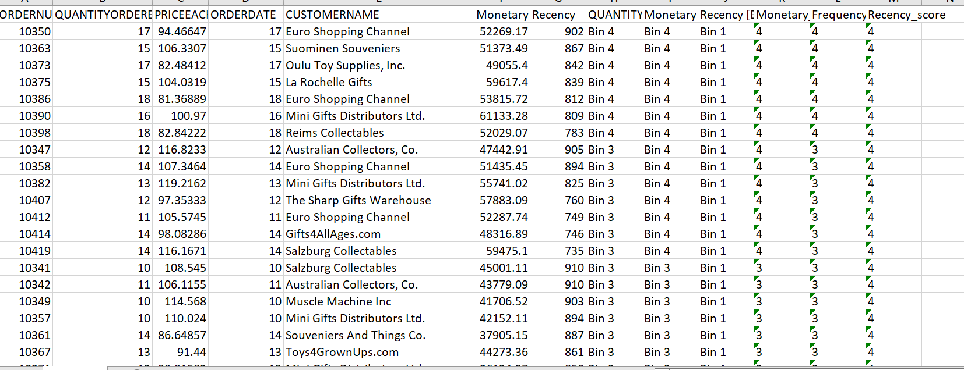
Customer Segmentation using RFM analysis
OUTPUT TABLE HEAD

Slide 26
INFERENCES FROM RFM ANALYSIS AND IDENTIFIED SEGMENTS
BEST CUSTOMERS
Those with RFM score 444
Euro Shopping Channel
Suominen Souveniers
Oulu Toy Supplies, Inc.
La Rochelle Gifts
Mini Gifts Distributors Ltd.

Slide 27
INFERENCES FROM RFM ANALYSIS AND IDENTIFIED SEGMENTS
CUSTOMERS ON THE VERGE OF CHURNING
Those with RFM score 144
Baane Mini Imports
Danish Wholesale Imports
Rovelli Gifts
Cruz & Sons Co.
AV Stores, Co.

Slide 28
INFERENCES FROM RFM ANALYSIS AND IDENTIFIED SEGMENTS
LOST CUSTOMERS
Those with RFM Value 111
Online Diecast Creations Co.
Blauer See Auto, Co.
Vitachrome Inc.
Volvo Model Replicas, Co
Mini Gifts Distributors Ltd.

Slide 29
INFERENCES FROM RFM ANALYSIS AND IDENTIFIED SEGMENTS
LOYAL CUSTOMERS
Those with RFM Value 444 OR 344 ETC (frequency remaining highest)
Euro Shopping Channel
Suominen Souveniers
Oulu Toy Supplies, Inc.
La Rochelle Gifts
Mini Gifts Distributors Ltd.
Reims Collectables
L'ordine Souveniers
Petit Auto

Slide 30
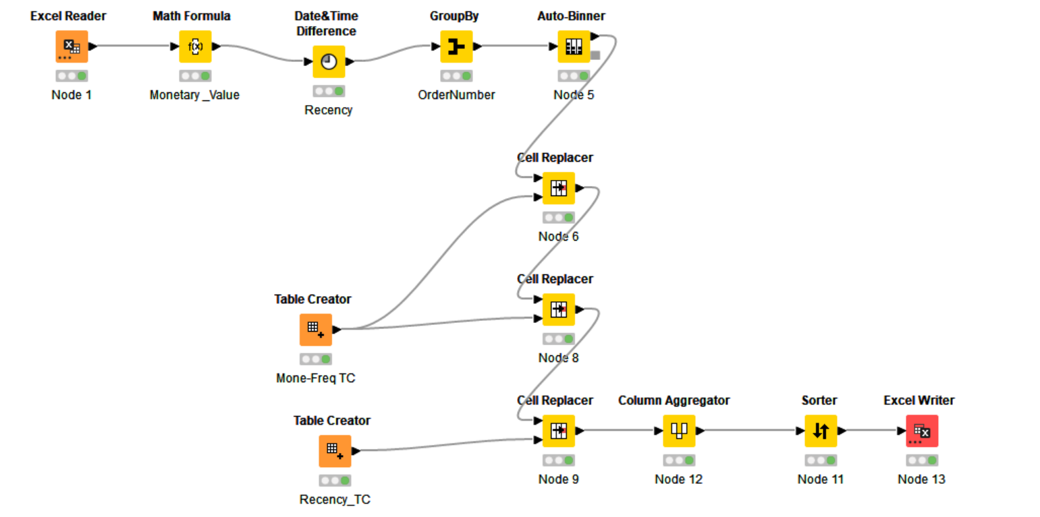
KNIME WORKFLOW

Slide 31
THANK YOU

